Slide 1
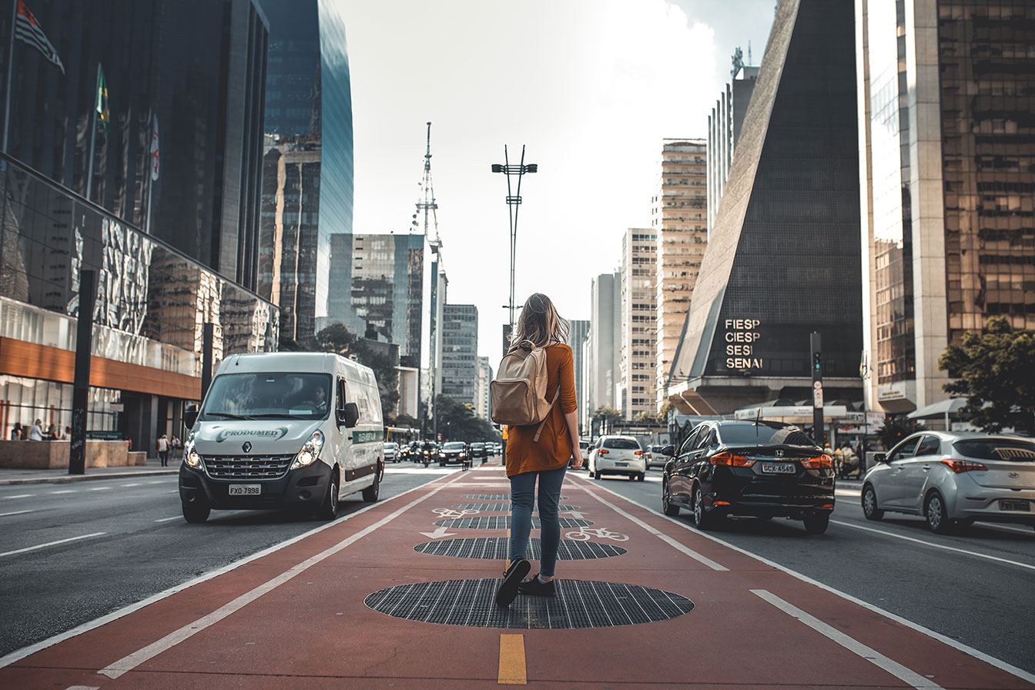
“Our paths will lead you to a safer world”
~TEAM MUSKAN

Slide 2
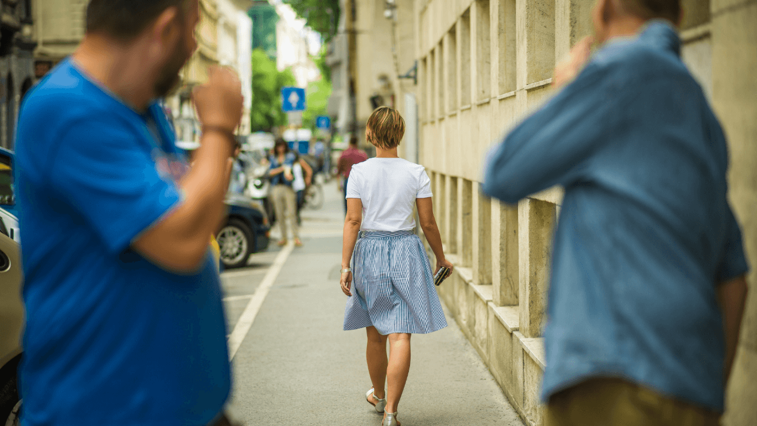

Slide 3
The problem we are aiming to solve :-
Unfortunately, women who commute to work on foot also experience harassment on a regular basis. Catcalling and other forms of street harassment are common in cities all over the country.
We are planning to build an application /web app using Google map API which will suggest the Safest and Shortest path /route in a locality for women to travel .

Slide 4
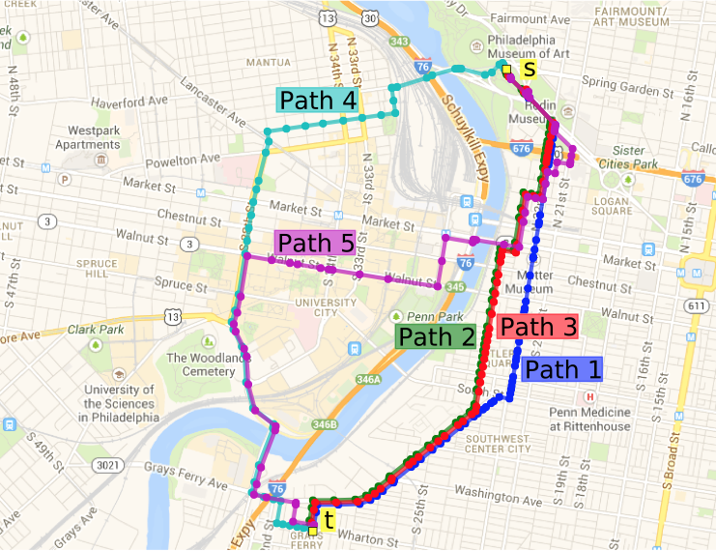

Slide 5

Some additional features of our project :-
We can connect our users travelling on the same route. Like one girl will be confident if she knows that two more users are travelling by the same route as she is .
But we wouldn't disclose their positions to each other .In case the they want to connect then they will have to send a request to each other for doing so.

Slide 6
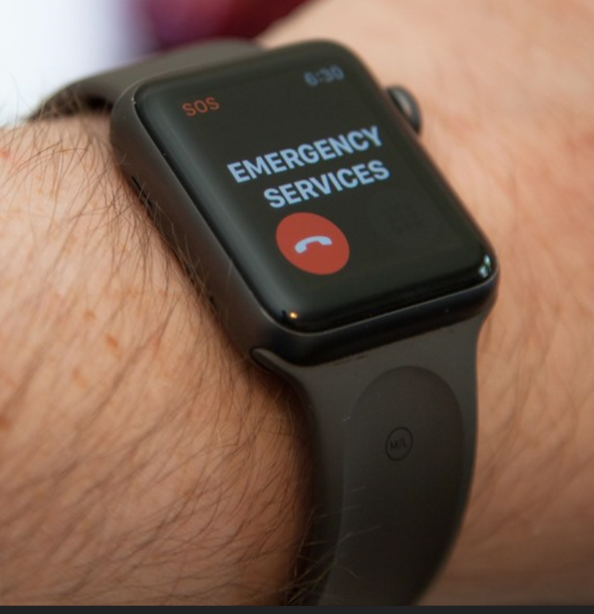
Some additional features of our project :-
Our application will also keep a track that if a user is taking more time than expected or if the user is going off track then an emergency signal can be send to their office , home or loved ones based on their choice .
SOS can also be added to this.

Slide 7
Novelty of our solution :
There is no such application which tells the Safest path for Women to travel . Using this application the users can stay safe and commute to work without any problem.
#Dontletthesenightsstopyou

Slide 8
Contact us :-
Product name:- “Our paths will lead you to a Safer world”
Email:-rakshitmaggon70@gmail.com
Phone No.-+91 8920533487
Location :-Vellore Institute of Technology, Vellore
632014,Tamil Nadu , India
Company name:-MUSKAN
Meet the team :-
Rakshit Maggon
Muskan Agarwal
Karan Rochlani
Muskan Agarwal

